Slide 1





Day 6 MySQL Index & Query Tuning
Sean Wong
2025/08/04

Slide 2
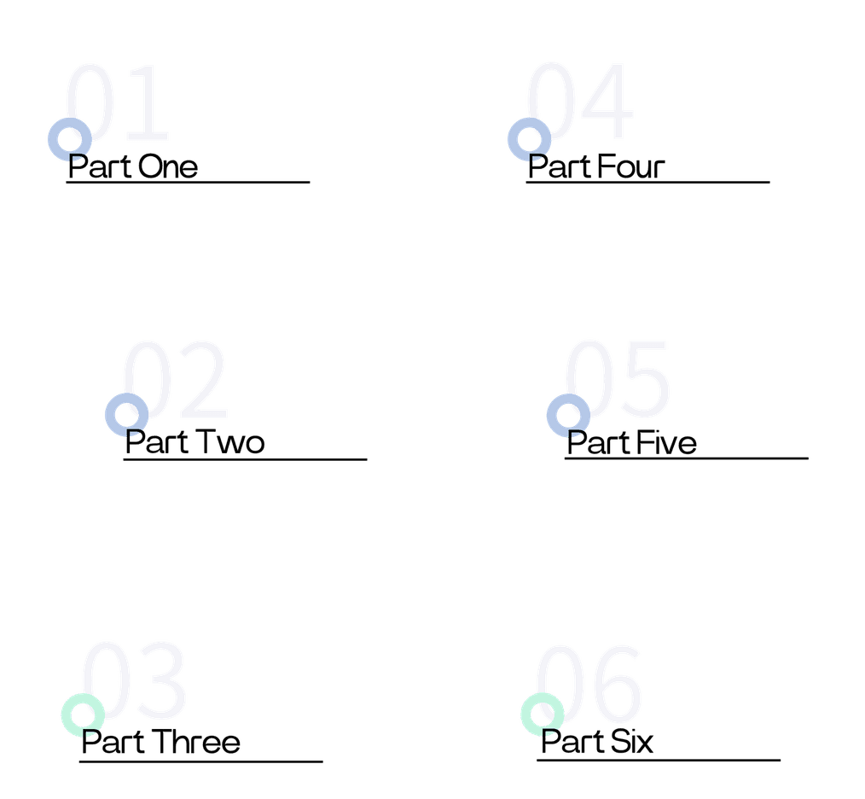

CONTENTS
Index Fundamentals
Index Lifecycle
EXPLAIN Deep Dive
Query Optimization
Best Practices
Hands-On & Wrap-Up

Slide 3

Index Fundamentals

Slide 4


Performance Benefits
What Are Database Indexes
Indexes significantly improve query performance, especially for large datasets. They enhance the efficiency of SELECT, JOIN, and ORDER BY operations by reducing the number of rows that need to be scanned.
Index Definition
An index is a data structure that accelerates the retrieval of rows from a database table. It acts like a book index, allowing you to quickly locate specific pages without reading the entire book.
Trade-offs
While indexes speed up read operations, they consume additional storage space and can slow down write operations like INSERT, UPDATE, and DELETE. Balancing these trade-offs is crucial.

Slide 5

Primary Key Index
Primary Key Index is automatically created with the PRIMARY KEY constraint. It ensures unique values and non-null entries, providing a unique identifier for each row in the table.
Unique Index
Unique Index ensures that all values in the specified column(s) are unique. It is useful for enforcing uniqueness constraints on columns other than the primary key.
MySQL Index Types Overview

Slide 6
Index Lifecycle

Slide 7

Creating Dropping Indexes
Creating Composite Index
For multi-column searches, create a composite index using: CREATE INDEX index_name ON table_name (column1, column2);. This optimizes queries involving multiple columns.
Creating Index
To create an index, use the syntax: CREATE INDEX index_name ON table_name (column_name);. This helps speed up queries on the specified column.
Dropping Index
To drop an index, use the syntax: DROP INDEX index_name ON table_name;. This removes the index and frees up storage space.
Index Considerations
Create indexes on columns frequently used in queries. Avoid excessive indexes to prevent overhead on write operations. Only index columns that significantly improve query performance.

Slide 8
EXPLAIN Deep Dive

Slide 9

EXPLAIN Plan Anatomy
EXPLAIN Statement
The EXPLAIN statement provides detailed information about how MySQL executes a query. It helps identify bottlenecks and optimize query performance.
EXPLAIN Output Columns
EXPLAIN output includes columns like id, select_type, table, type, key, rows, and Extra. These columns reveal the execution plan, index usage, and estimated costs.

Slide 10


Decoding Type Column
Access Methods
Efficiency Indicators
Optimization Goal
The type column in EXPLAIN indicates the access method used. Common values include ALL, index, range, eq_ref, ref, const, and system.
ALL signifies a full table scan, which is inefficient for large tables. Range and ref are more efficient, indicating indexed lookups that reduce the number of rows examined.
Aim to replace ALL with range or ref in the type column to minimize unnecessary data scans and improve query performance.

Slide 11

Live EXPLAIN Walkthrough
Example Query
Consider the query: EXPLAIN SELECT * FROM employees WHERE department_id = 3;. The EXPLAIN output shows type=ref, key=idx_dept, rows=10, indicating efficient index usage and reduced row scans.

Slide 12
Query Optimization

Slide 13

Index Driven WHERE JOIN ORDER
Indexing for JOIN and ORDER BY
Indexing for WHERE
Index columns used in WHERE clauses to speed up filtering operations. This reduces the number of rows that need to be scanned, improving query performance.
Use indexes on columns involved in JOIN conditions and ORDER BY clauses. This ensures efficient sorting and joining operations, enhancing overall query efficiency.

Slide 14




Avoid SELECT *
Avoid using SELECT * in production queries. Instead, specify only the columns you need to reduce I/O operations and improve performance.
Low-Cardinality Columns
SELECT and Cardinality Pitfalls
Avoid indexing low-cardinality columns like gender or boolean flags. These columns offer little selectivity and can lead to inefficient index usage.
High-Cardinality Columns
Index high-cardinality columns to maximize filter efficiency. These columns have a wide range of distinct values, making indexes more effective.

Slide 15






Before After Optimization Tale
Optimization Example
Compare an unindexed query with a post-index version. Adding an index on last_name changes the EXPLAIN output from type=ALL to type=ref, significantly reducing row reads and improving query speed.

Slide 16
Best Practices

Slide 17

Index Frequent Queries
Create indexes on columns frequently used in queries to speed up read operations. This ensures that common queries are optimized for performance.
Golden Rules for Indexing
Remove Redundant Indexes
Composite Indexes
Regularly review and remove redundant indexes to avoid unnecessary overhead on write operations. This keeps the indexing strategy efficient.
Use composite indexes for multi-column filters to optimize queries involving multiple columns. This reduces the need for multiple single-column indexes.
Monitor Write Workload
Monitor the impact of indexes on write operations like INSERT, UPDATE, and DELETE. Balance indexing needs with write performance to maintain overall efficiency.

Slide 18



Measure and Optimize
Use EXPLAIN to measure slow queries, add or adjust indexes, and retest execution plans. Document changes and regularly re-audit performance as data grows.
Iterative Process
Optimization is an ongoing process. Continuously monitor query performance, adjust indexes, and refine strategies to adapt to changing data and usage patterns.
Continuous Performance Cycle

Slide 19
Hands-On & Wrap-Up

Slide 20





Key Takeaways
Indexes accelerate read operations, EXPLAIN helps identify bottlenecks, and optimization is an iterative process. Regularly review and adjust indexes as data evolves.
Continuous Improvement
Lab Tasks
Embed optimization as an ongoing habit. Regularly measure query performance, adjust indexes, and document changes to maintain efficient database operations.
Create single and composite indexes on sample tables. Run EXPLAIN on queries to analyze performance. Optimize a JOIN statement using appropriate indexes.
Lab and Key Takeaways

Slide 21



Sean Wong
2025/08/04

